Slide 1

IMIGRANS
Educational Traveling

Slide 2
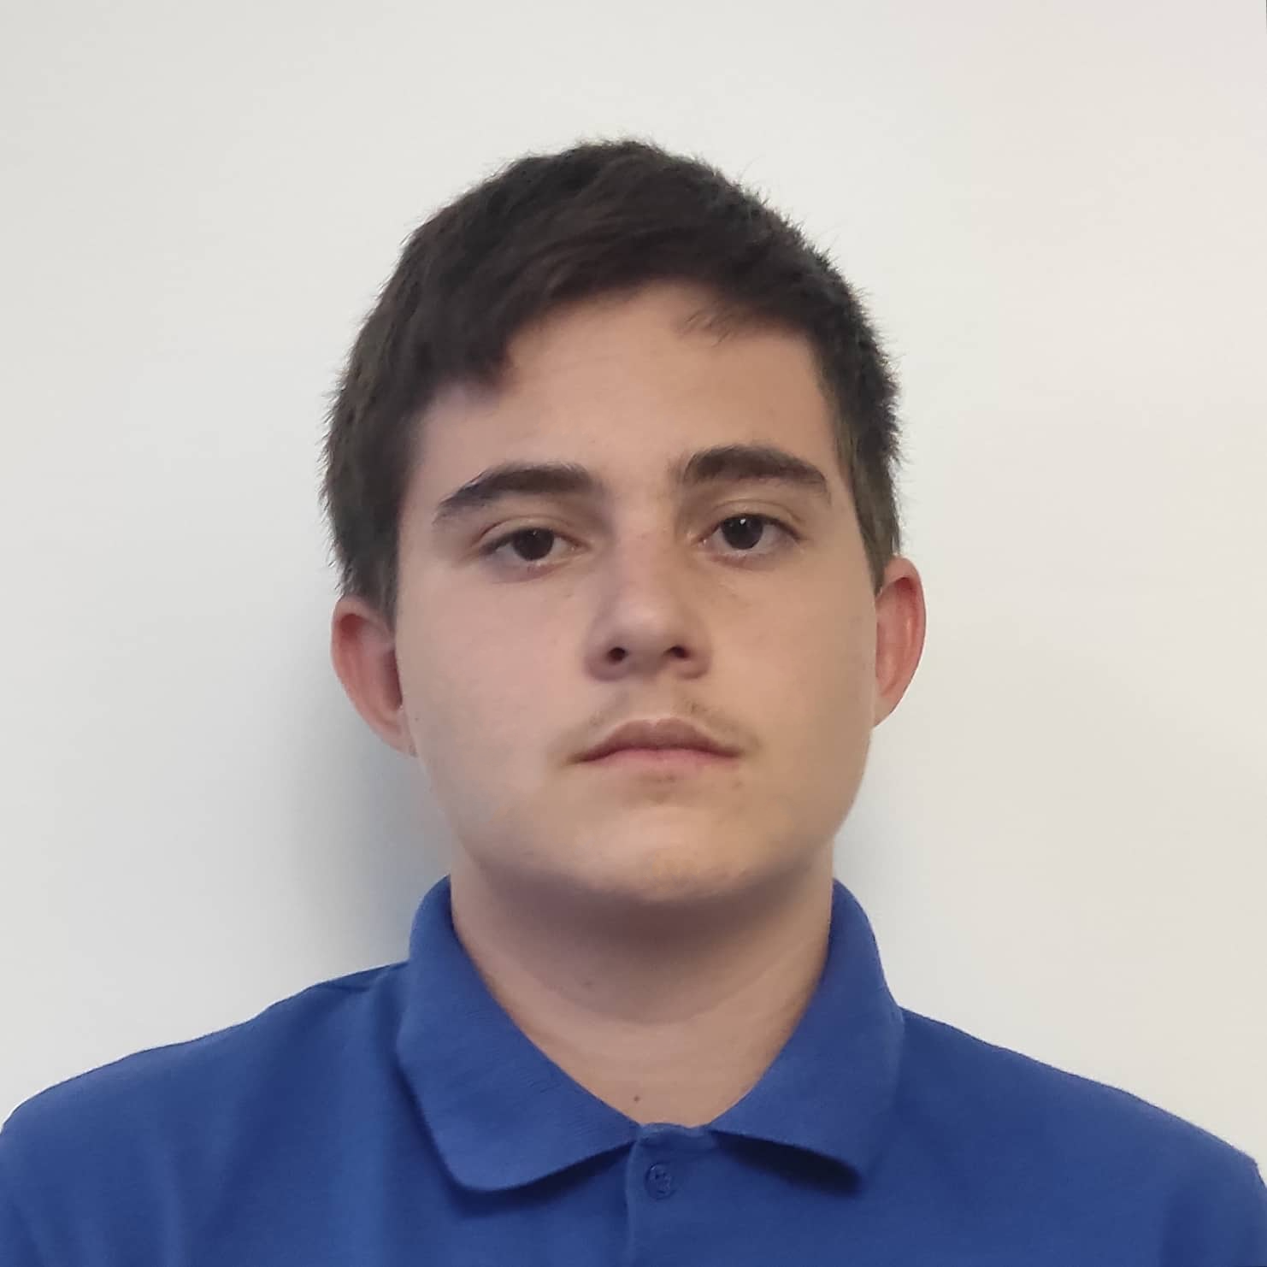
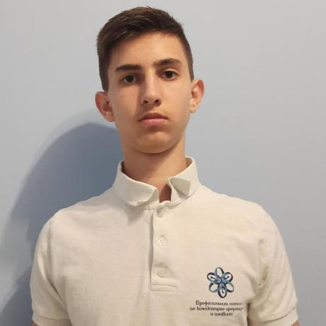
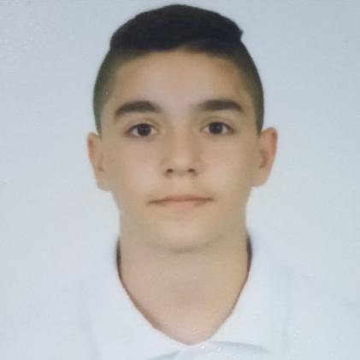
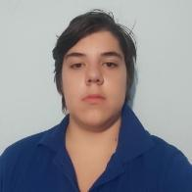
The Team
Scrum Trainer
BackEnd Developer
QA Engineer
BackEnd Developer
Martin Kafedzhiev
Nikolai Despotov
Ivan Tsrangalov
Alexander Kostov

Slide 3
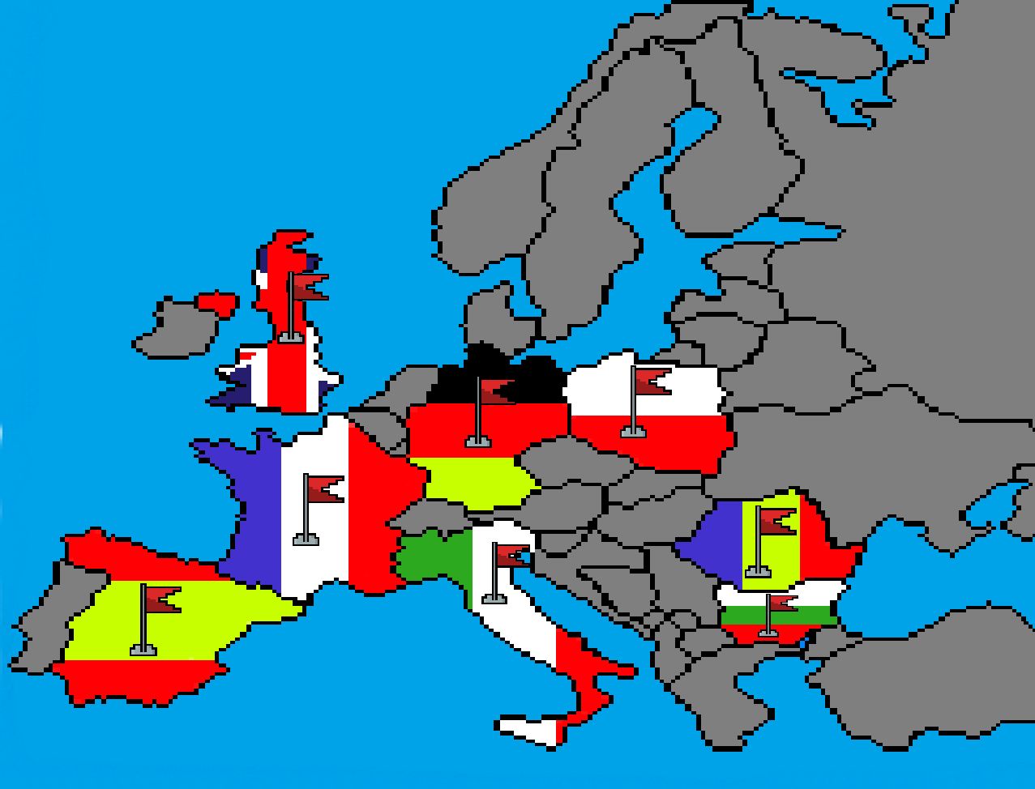
Idea
Our idea was to create a game where you are an immigrant travelling from a foreign country to Europe. You have limited resources and need to find a way to visit a total of 5 countries and make money along the way

Slide 4
Realization
1
2
3
4
5
Task
Realization
Present
Organisation
Test

Slide 5











Technologies Used

Slide 6
Let’s take a look at the game

Slide 7
Thank you for your attention

